Slide 1
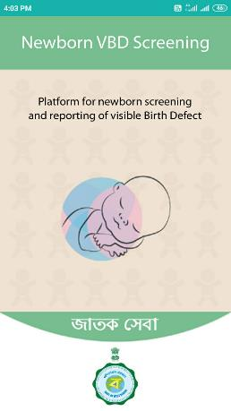
Visible Birth Defect (VBD) Screening
জাতক সেবা
স্বাস্থ্য ও পরিবার কল্যাণ দপ্তর পশ্চিমবঙ্গ সরকার
Riddhi Management Services Pvt. Ltd.

Slide 2
Process
Data Capturing / Uploading
Installing the Mobile Application from http://wbvbd.jatakseva.com
Screening of newborns using the mobile application
User Registration
Data Viewing and Monitoring : http://wbvbd.jatakseva.com

Slide 3
How to register your mobile application?
Note-This is a one-time activity and needs to be followed for the very first time before starting to use the application

Slide 4
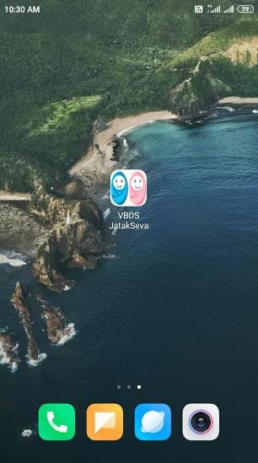
How to register?
Tap on
VBDS-JatakSeva icon
This splash screen will appear

Slide 5
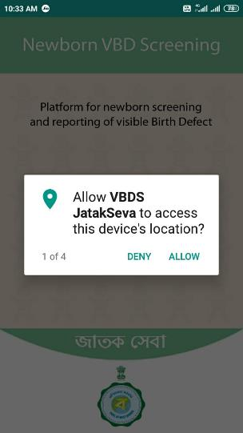
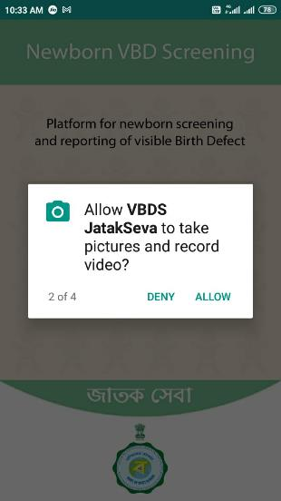
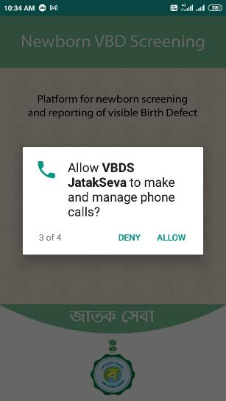
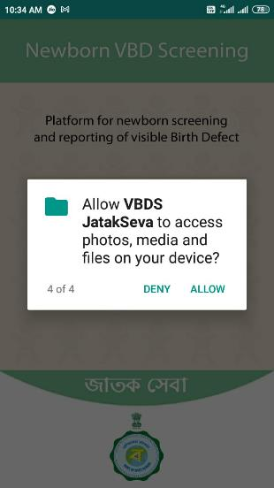
How to register?
Note – The application will ask for certain permissions, please ALLOW ALL

Slide 6
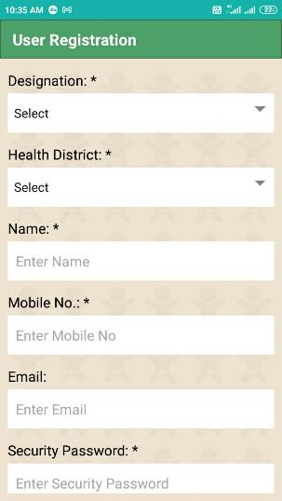
User Registration
Note- Mobile internet connectivity is required for user registration
Select your Designation (Staff Nurse, BPHN, DPS etc.)
Select Health District, Institution Type (MCH, DH etc.), Delivery Point Name
Enter your Name and Phone number
Scroll the registration page downwards

Slide 7
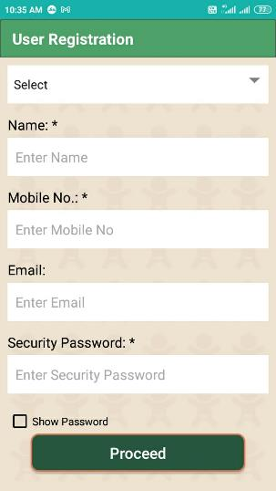
User Registration
Note- Mobile internet connectivity is required for user registration
Enter your Email ID and VBD APP Security Password
Now, tap on <Proceed>

Slide 8
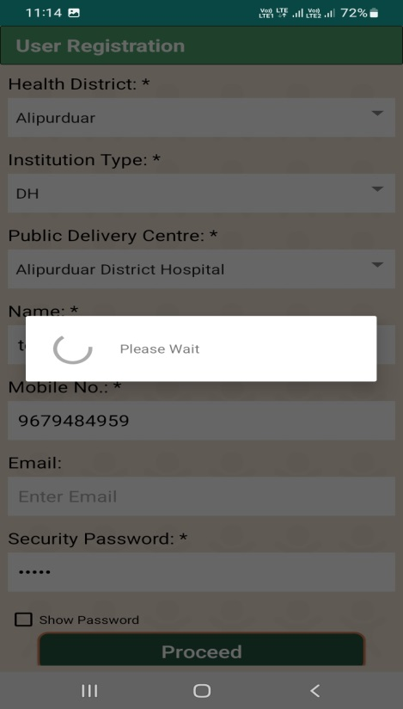
User Registration
Note- Mobile internet connectivity is required for user registration
Registering…..

Slide 9
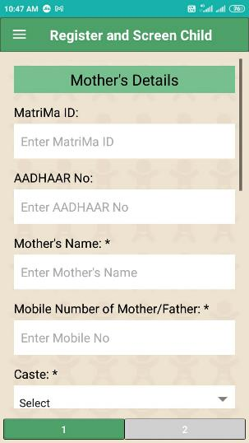
User Registration
✓
Registration Completed

Slide 10
Pre-requisite
(before using the app)

Slide 11
Pre-requisite
The date-time setting of your phone MUST be in Auto Mode (Network Provided)
And NOT in manual mode
If your mobile handset’s date-time setting is in manual mode, the app will not allow to proceed

Slide 12
Application Modules

Slide 13
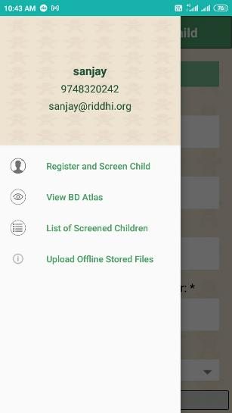
Application Modules
Tap here to open the Sidebar
Modules of the App

Slide 14
How to register and screen a Newborn ?

Slide 15
Newborn Screening
Tap here to open the Sidebar
Tap on ‘Register and Screen Child’

Slide 16
Newborn Screening
Enter 10-digit MatriMa ID of the mother (if available)
Enter AADHAAR No. of the mother
Enter Name of the mother
Enter Mobile No. of the mother/father
Select Caste from the drop down
Scroll the page downwards

Slide 17
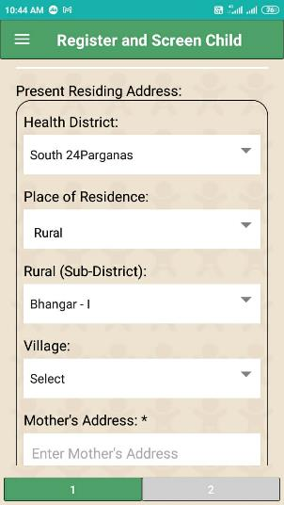
Newborn Screening
Mother’s Present Residing Address
Select Health District & Place of Residence (Rural or Urban) of the mother
If RURAL, then select Sub District, village from the respective drop-down menus and enter Address of the Mother (Address is Mandatory)
Scroll the page downwards

Slide 18
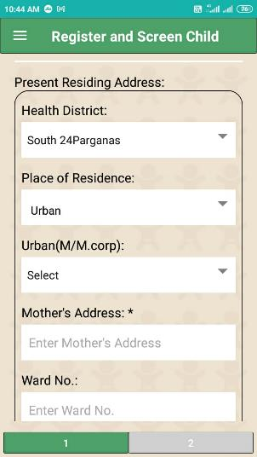
Newborn Screening
Mother’s Present Residing Address
Select District & Place of Residence (Rural or Urban) of the mother
If URBAN, then select M/M.Corp. name and enter ward number, address of the mother (Address is Mandatory)
Scroll the page downwards

Slide 19
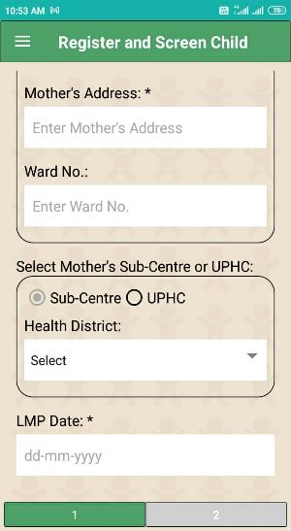
Newborn Screening
Select Sub-Centre or UPHC Name (where the mother is registered)
Enter LMP date of the mother
Tap on Page 2

Slide 20
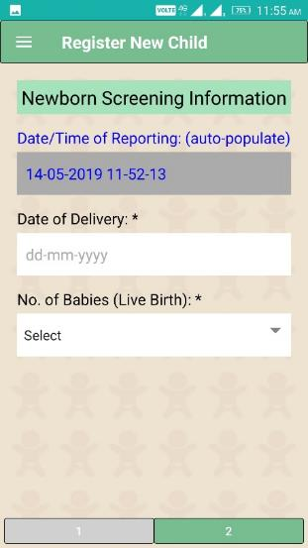
Newborn Screening
Date and Time of Newborn screening will be auto-populated in the app
Enter Date of Delivery
Select No. of Live Birth (values available: 1 to 4)

Slide 21
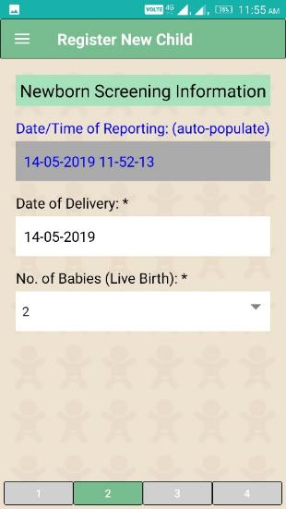
Newborn Screening
Select No. of Live Birth (values available: 1 to 4)
Based on this selection, respective pages for child screening will be visible
Example 1: No. of Live Birth entered = 2 and
Page No. 3, 4 is visible for screening of two children

Slide 22
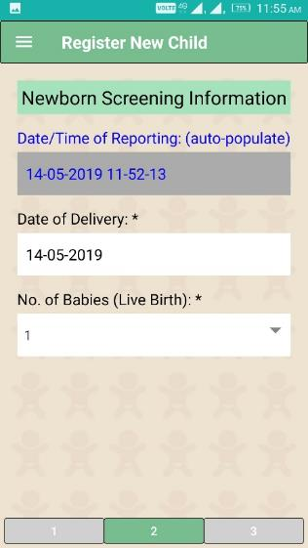
Newborn Screening
Select No. of Live Birth (values available: 1 to 4)
Based on this selection, respective pages for child screening will be visible
Example 2: No. of Live Birth entered = 1 and
Page No. 3 is visible for screening of one child

Slide 23
Newborn Screening
Tap on Page 3 to enter screening details of the child

Slide 24
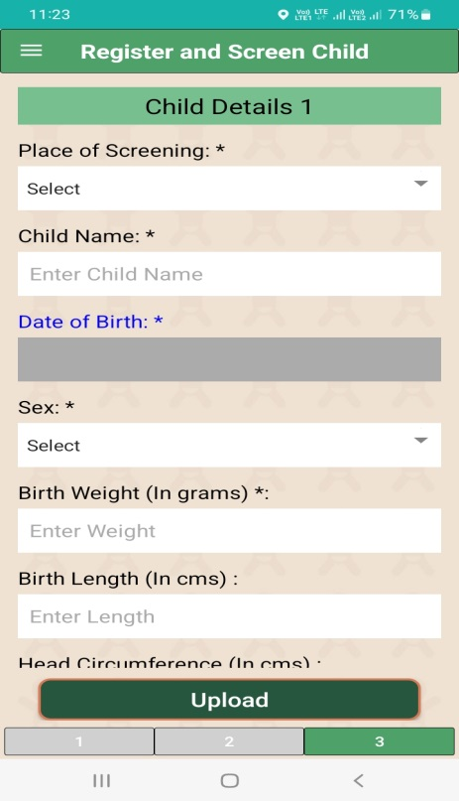
Newborn Screening
Select place of screening (PNC Ward or SNCU)
Enter child name (by default, the app will set the name as <Baby of + Mother’s Name>, you can change it, if original name is available
Date of Birth will be auto-populated by the app
Select Gender of the Child from the drop-down menu
Enter Birth Weight of the Child (in Grams)
Scroll the page downwards

Slide 25
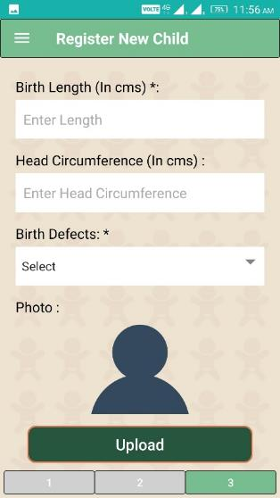
Newborn Screening
Enter Length of the Child (in Centimeter)
Enter Head Circumference of the Child (in Centimeter)
Select Presence of Birth Defect (Yes OR None)
If NONE, then tap on this Image to capture a picture of the child (Optional) and Upload the dataset

Slide 26
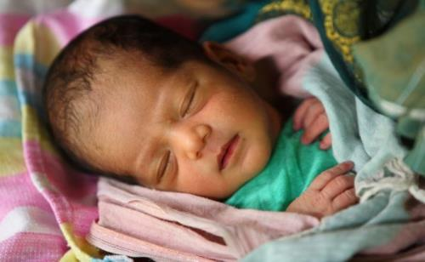
Newborn Screening
1
Tap on Camera Icon
2
You can view a preview of the image
3
Tap here to discard this image and to capture a new one
Tap here to continue with the captured one
4

Slide 27
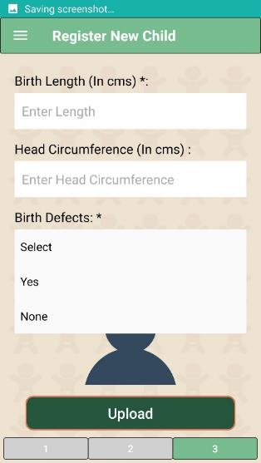
Newborn Screening
Select Presence of Birth Defect (Yes OR No)
If YES, then the following screen will appear for selecting specific birth defects of the child

Slide 28
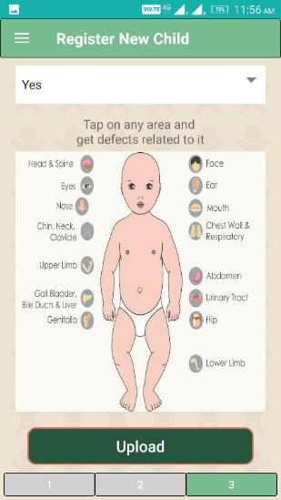
Newborn Screening
Tap on specific area of the body part to select visible birth defect/s (head to toe) of the child

Slide 29
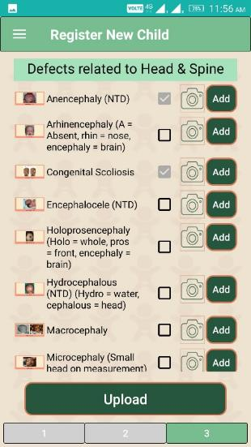
Newborn Screening
For Example, if you tap on ‘Head & Spine’…
List of Birth Defects (related to Head & Spine) will be visible for selection

Slide 30
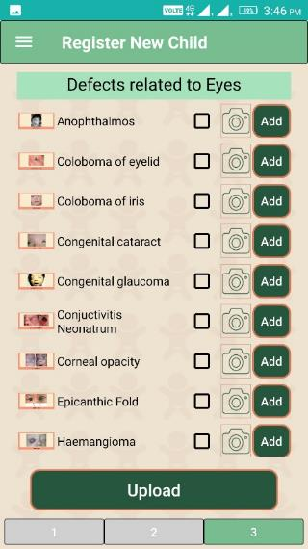
Newborn Screening
Another Example, if you tap on ‘Eyes’…
List of Birth Defects (related to Eyes) will be visible for selection

Slide 31
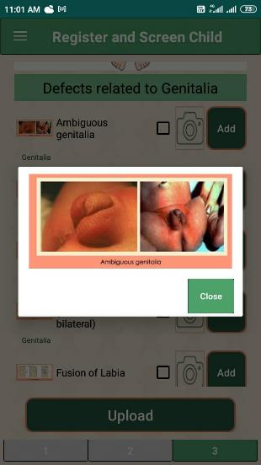
Newborn Screening
To view the image reference of any defect, please tap on the picture thumbnail and the same will be visible in a bigger size

Slide 32
Newborn Screening
Tap on the check-box for selecting the specific birth defect of the child and tap on respective <ADD> button for capturing the picture of the birth defect
NOTE: Tapping on <ADD> button is a MUST if you want to select the specific birth defect.
If you just select the check-box only and move to another body part (without tapping the ADD button), then the selected birth defect will not be saved for the child

Slide 33
Newborn Screening
Tap on the check-box for selecting the specific birth defect of the child and tap on respective <ADD> button for capturing the picture of the birth defect
Camera will be activated to capture the image

Slide 34
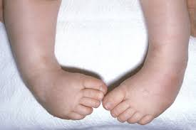
Newborn Screening
1
Tap on Camera Icon
2
You can view a preview of the image
3
Tap here to discard this image and to capture a new one
Tap here to continue with the captured one
4

Slide 35
Newborn Screening
Tap on Upload button to send the dataset in the web server

Slide 36
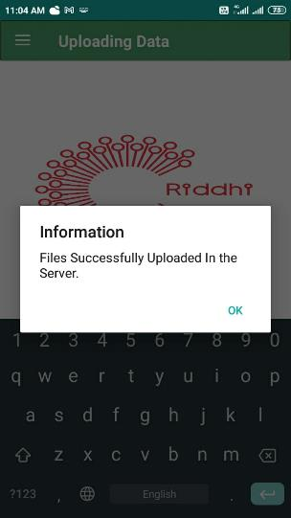
Newborn Screening
Captured dataset will be uploaded in the web server (if mobile internet connection is available)
Tap on <OK> to complete the process

Slide 37
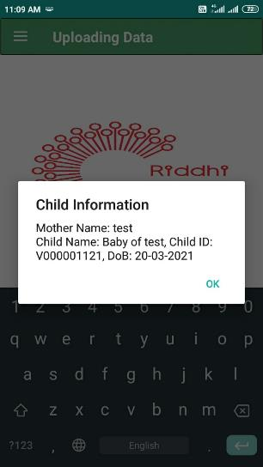
Newborn Screening
Once the data is uploaded in the web server, the child will get registered in the system and the web server will return the registered child ID, on real time.
Please note down the child ID (ten-digit unique ID in a year, i.e. V000001121, 21 stands for year) for future use and integration with other screening results.

Slide 38
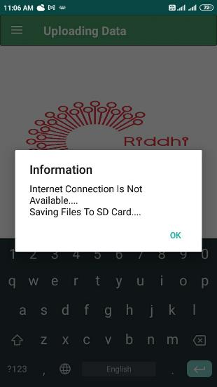
Newborn Screening
If internet connection is not available at the time of upload, then the data will be stored in the phone’s memory
Tap on <OK> to complete the process
Once the internet connection is available again, open the application to upload stored files
Note – Once these data files are uploaded in the web server, you need to login into the web portal to view the registered child ID of these children

Slide 39
How to upload stored files from phone memory?

Slide 40
Stored Files
Tap here to open the Sidebar
Tap on ‘Upload offline stored files’

Slide 41
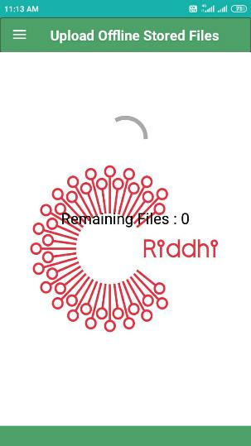
Stored Files
You can view the number of pending files (to be uploaded)
Note – If internet connection is available, no. of remaining files will gradually become 0 (zero)

Slide 42
How to view Birth Defect Pictorial Atlas (to know more about a specific defect) ?

Slide 43
Birth Defect Pictorial Atlas
Tap here to open the Sidebar
Tap on ‘View BD Atlas’

Slide 44
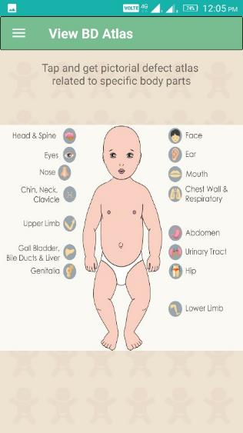
Birth Defect Pictorial Atlas
Tap on specific area of the body part to view specific visible birth defect/s of the child

Slide 45
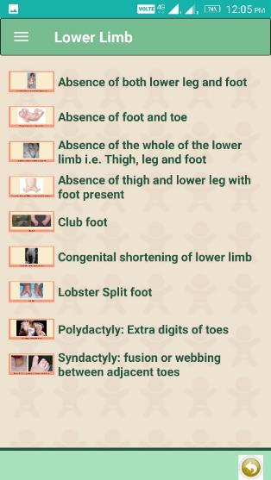
Birth Defect Pictorial Atlas
For Example, if you tap on ‘Lower Limb’…
List of Birth Defects (related to Lower Limb) will be visible for reading

Slide 46
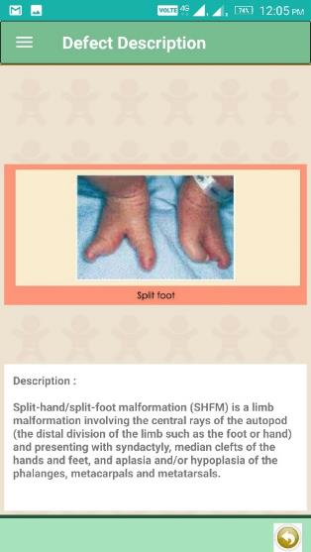
Birth Defect Pictorial Atlas
Tap on any defect to read more about it

Slide 47
How can I view the list of registered children (screened and uploaded by me)?

Slide 48
List of registered children
Tap here to open the Sidebar
Tap on ‘List of Screened Children’

Slide 49
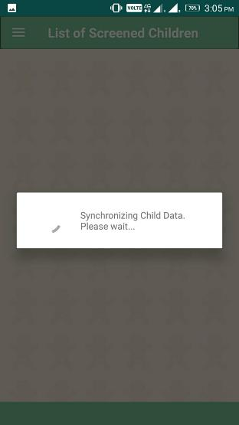
List of registered children
Note- Mobile internet connectivity is required for report download
Please wait while the app downloads the report from the web server…..

Slide 50
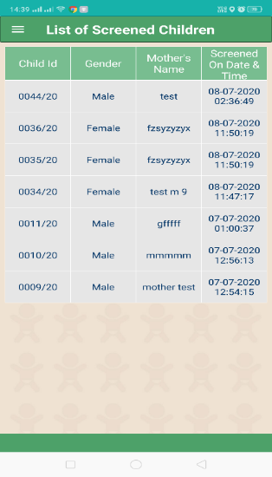
List of registered children
Note- Mobile internet connectivity is required for report download
Report Downloaded with child id

Slide 51
Caution Do not use the BACK button of the PHONE while using the mobile application

Slide 52
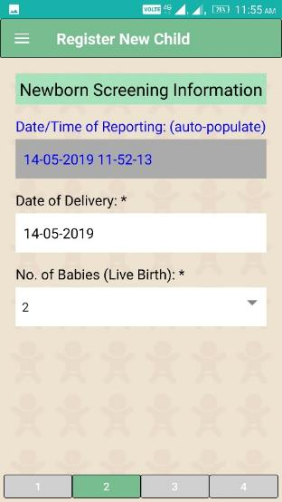
CAUTION
Caution
While screening a child, you can tap and move to any Section of the data forms (1, 2, 3 ….) for entering data in the respective data fields
Until and unless you tap on the UPLOAD button (available in the last page), all data (which you have entered for a child) will not be SAVED Permanently
Meanwhile (before tapping the UPLOAD button), if you tap on the BACK button of the MOBILE PHONE, the VBD application will show a Warning Message (confirmation to EXIT)

Slide 53
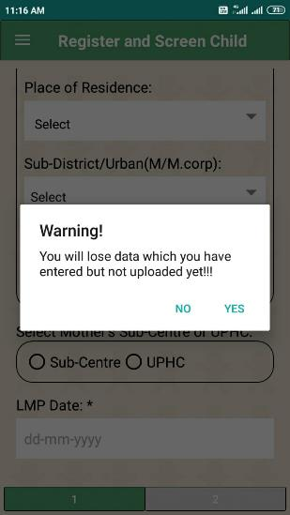
CAUTION
Caution
If you tap on YES, you will lose the data which you have entered and not uploaded yet.
Please proceed with CAUTION

Slide 54
Thank You!

